Slide 1

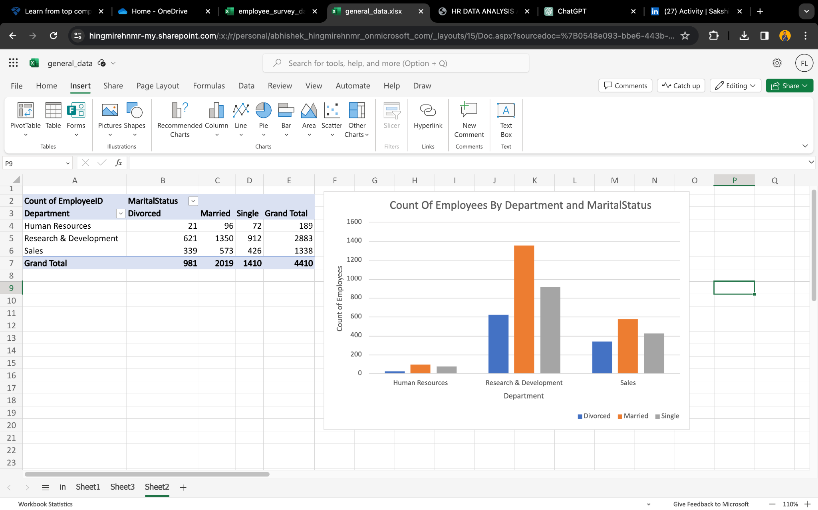


PHARMA DATA
ANALYSIS
Abhishek Hingmire

Slide 2
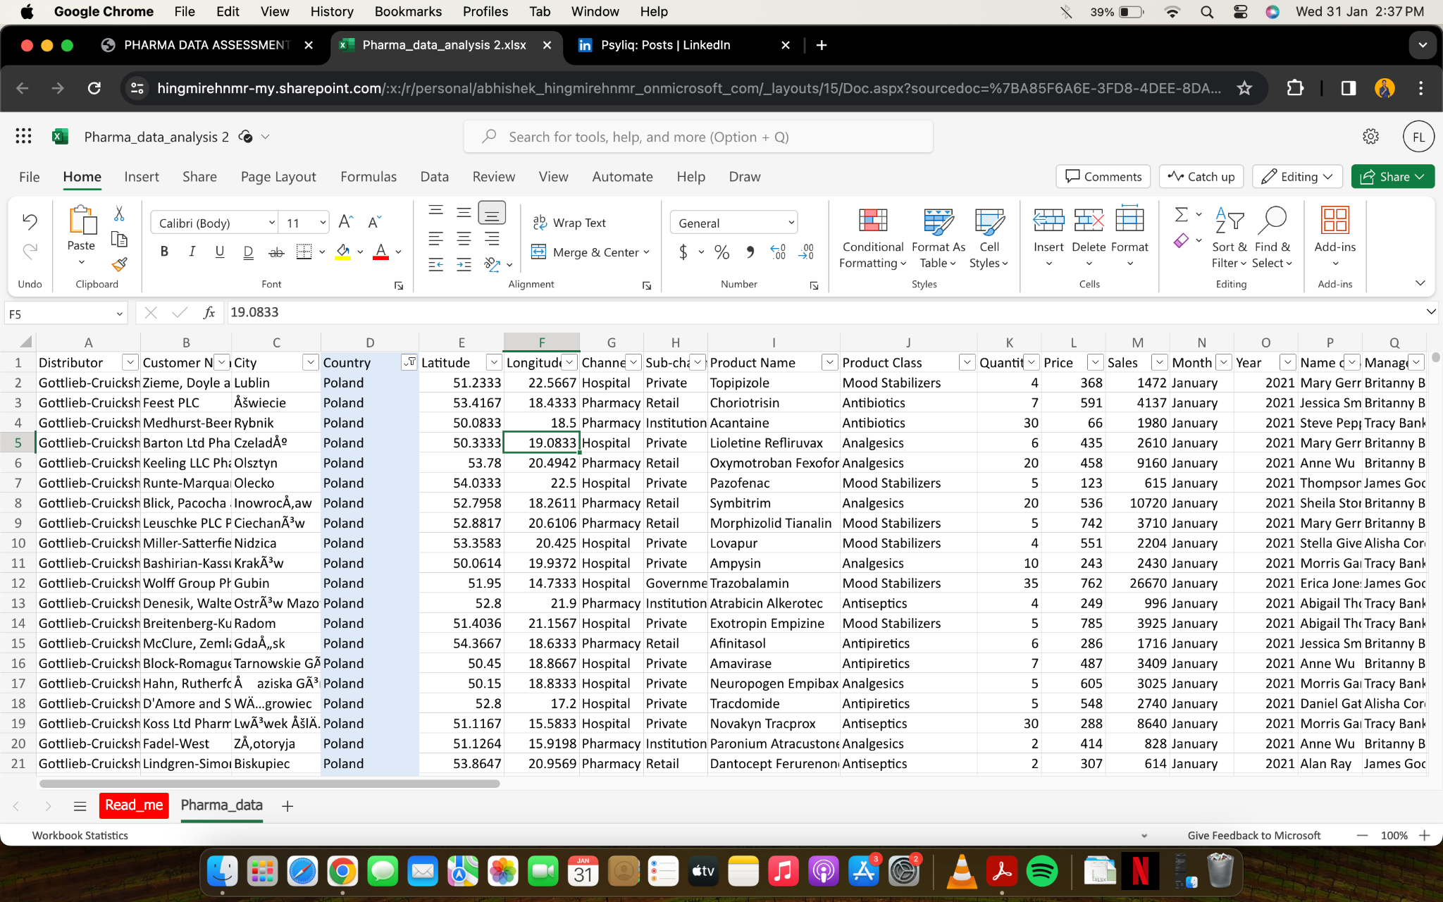
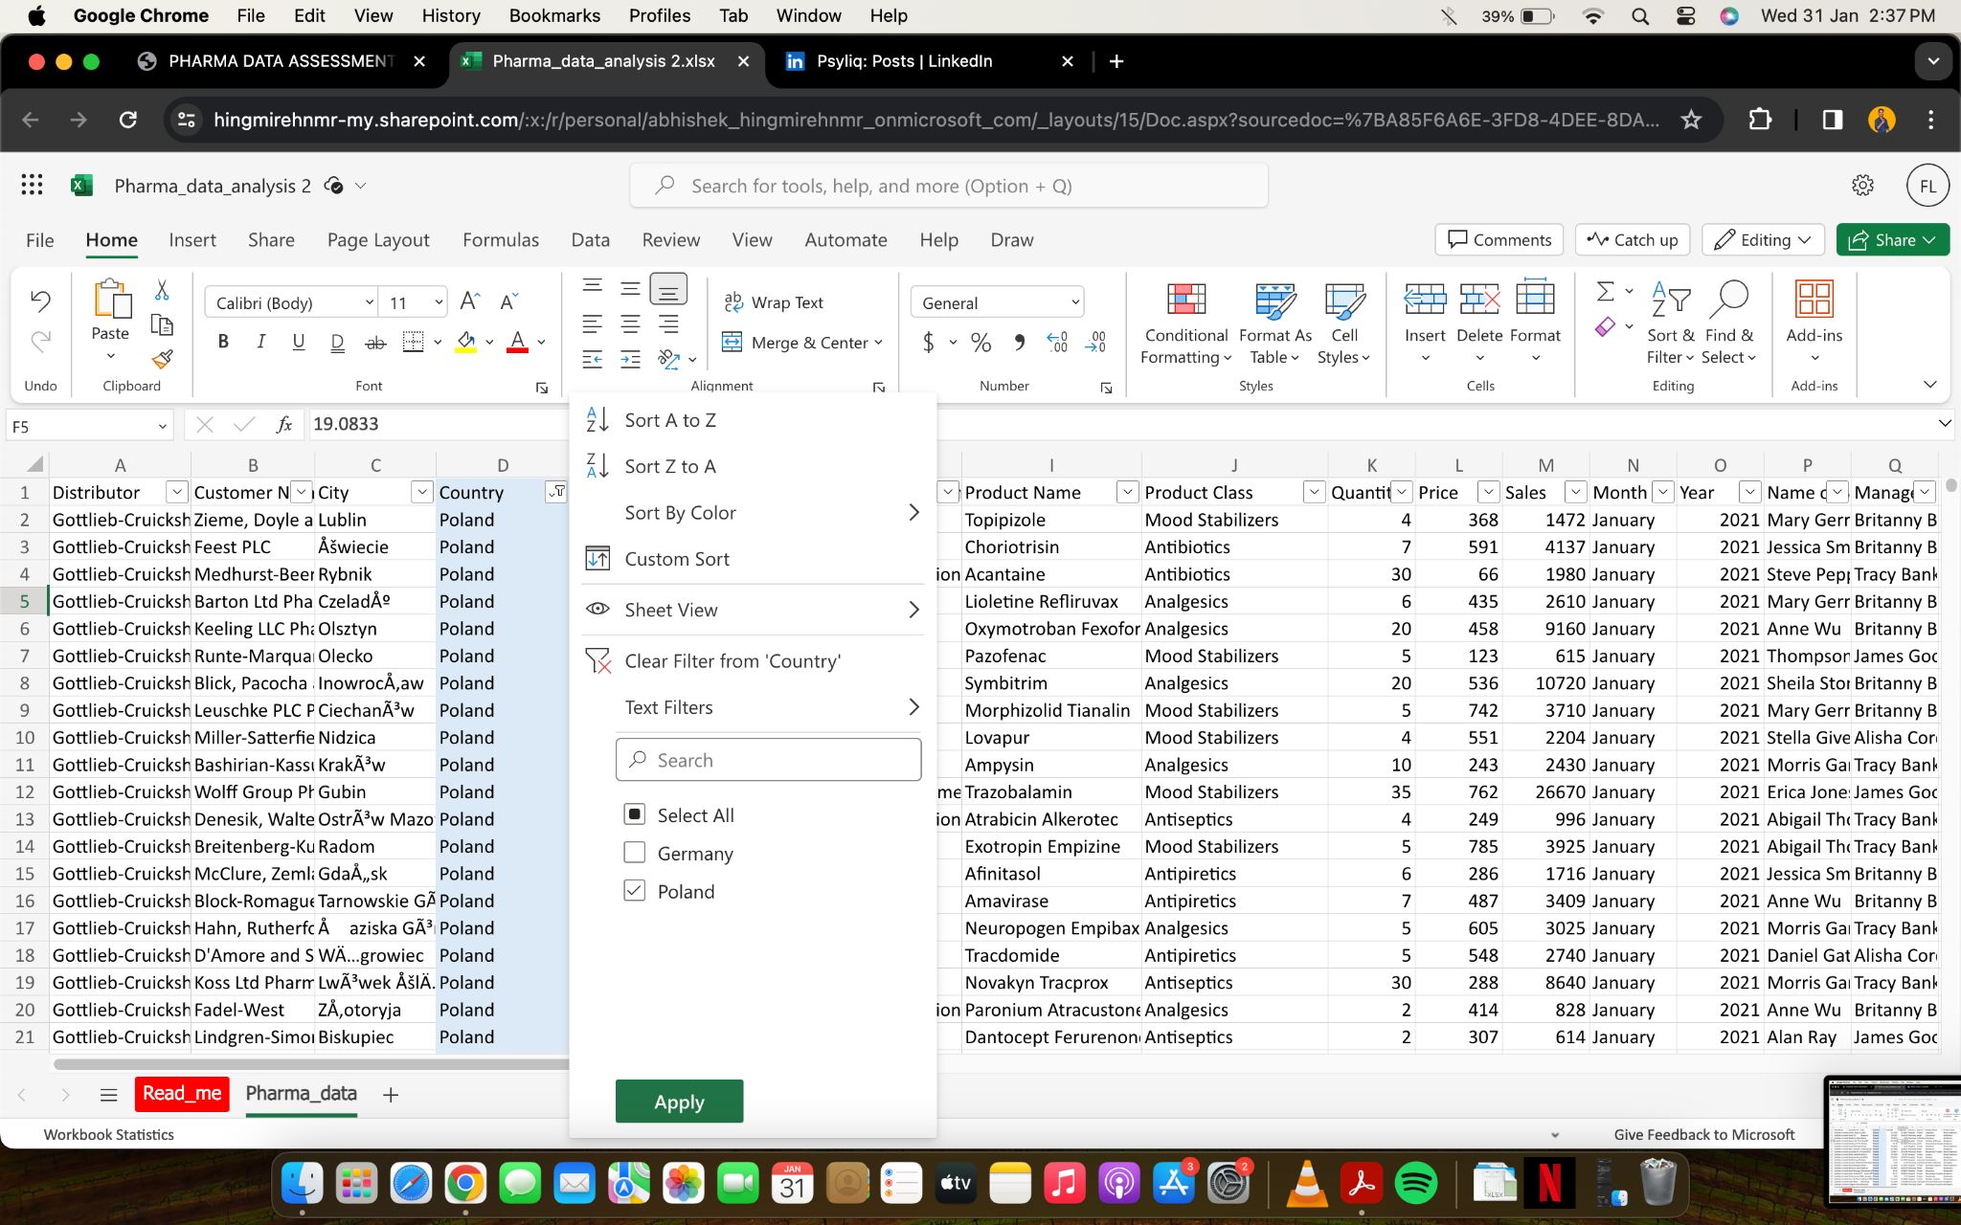
Basic Filtering: Can you filter the data to show only the records for a specific country, let's say "United States"?
“United States” is not mentioned in Country Column. So I have filtered the data for “Poland” Country

Slide 3
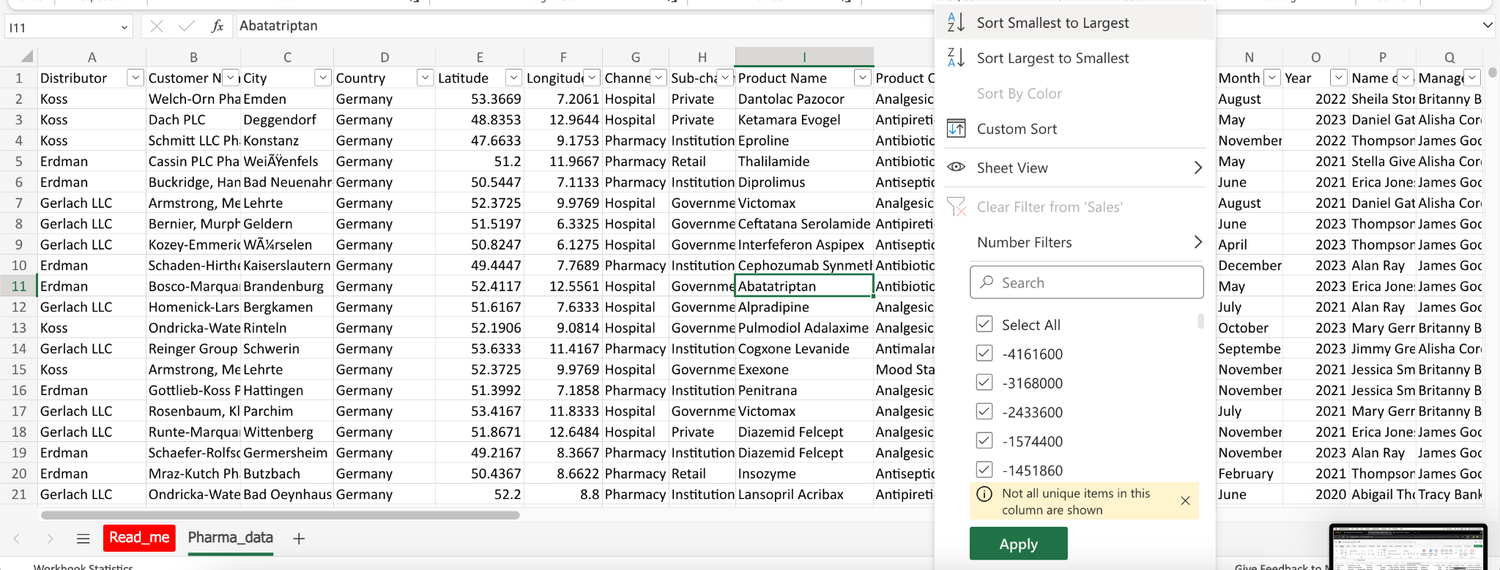
2. Sorting Data: How would you sort the data in ascending order based on the "Sales" column?

Slide 4
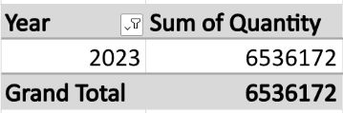
3. Summarizing Data: What is the total quantity of all products sold in the year 2023?
1

Slide 5
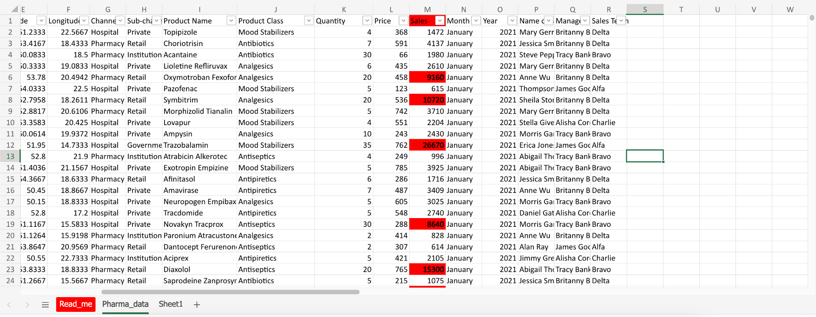
4. Conditional Formatting: Apply conditional formatting to highlight all sales greater than $5,000 in the "Sales" column.

Slide 6
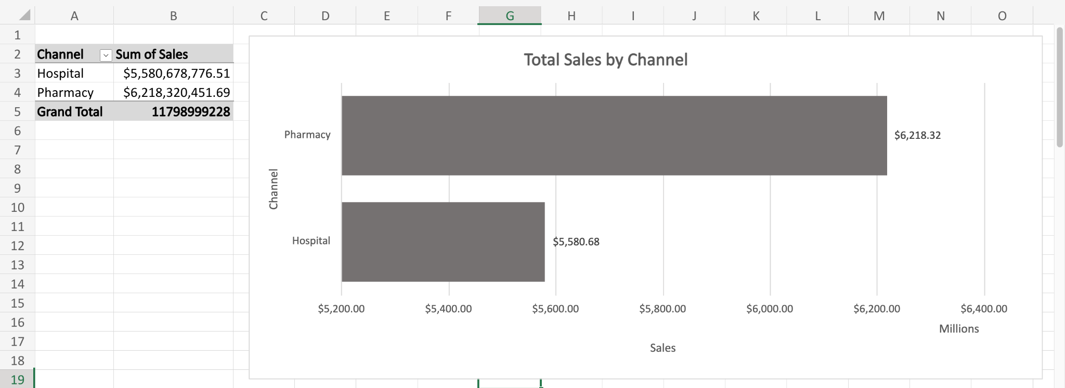
5. Simple Pivot Table: Create a pivot table to summarize total sales by "Channel."

Slide 7
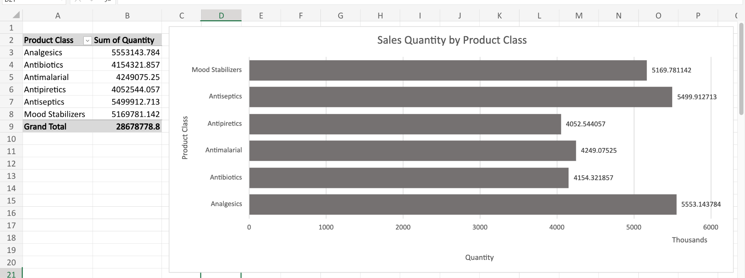
6. Basic Chart: Generate a bar chart to visualize the sales quantity by "Product Class."

Slide 8
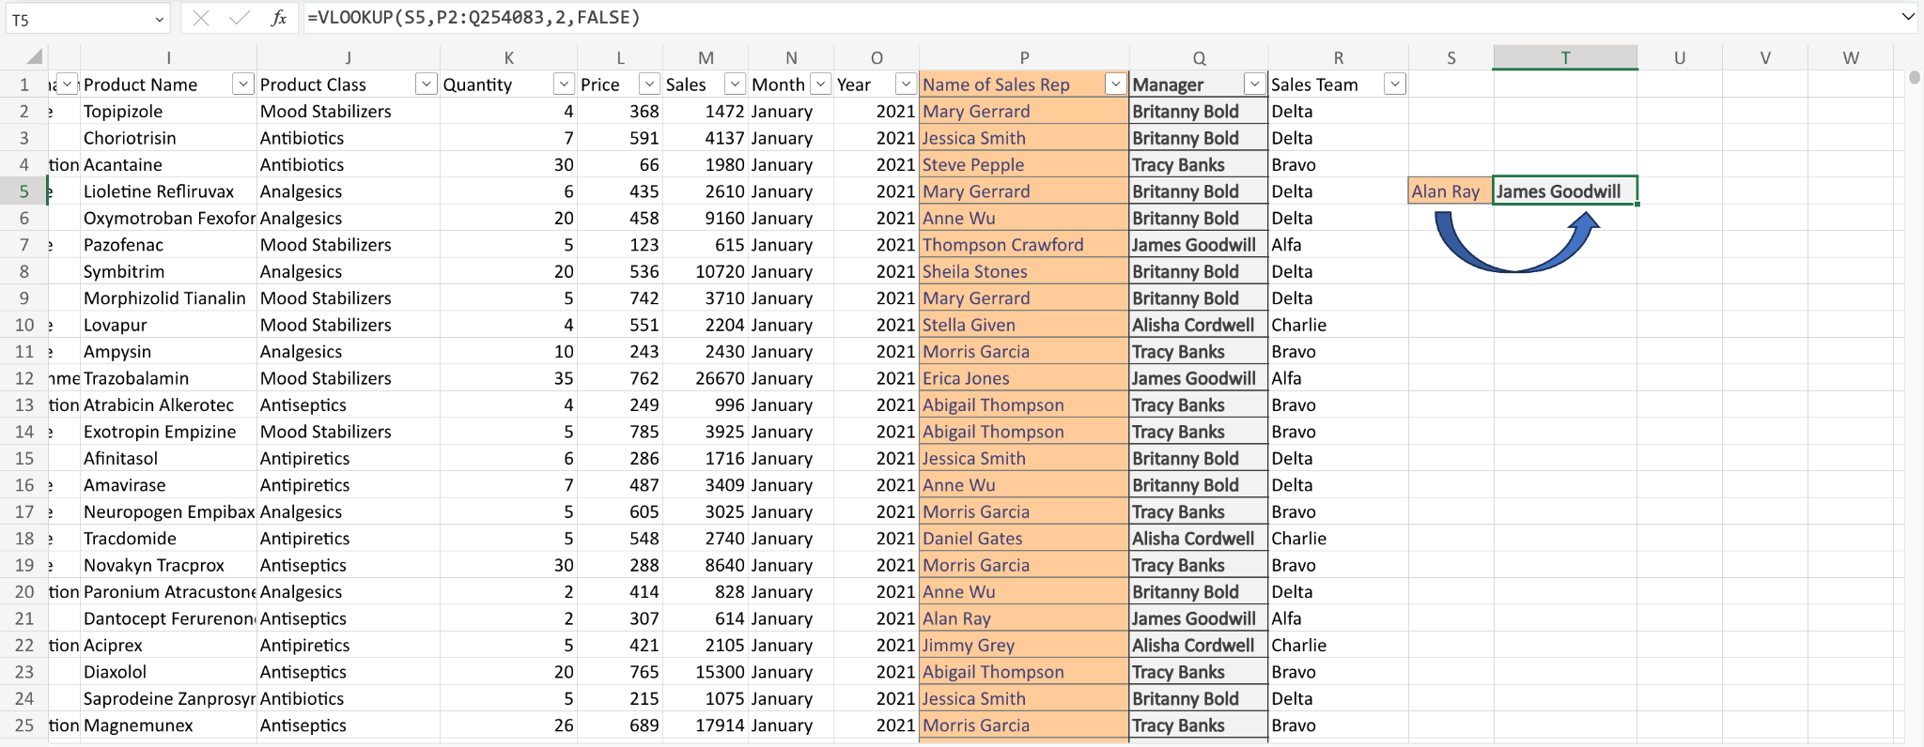
7. VLOOKUP Function: Can you use the VLOOKUP function to find the "Manager" for a specific "Sales Rep"?

Slide 9
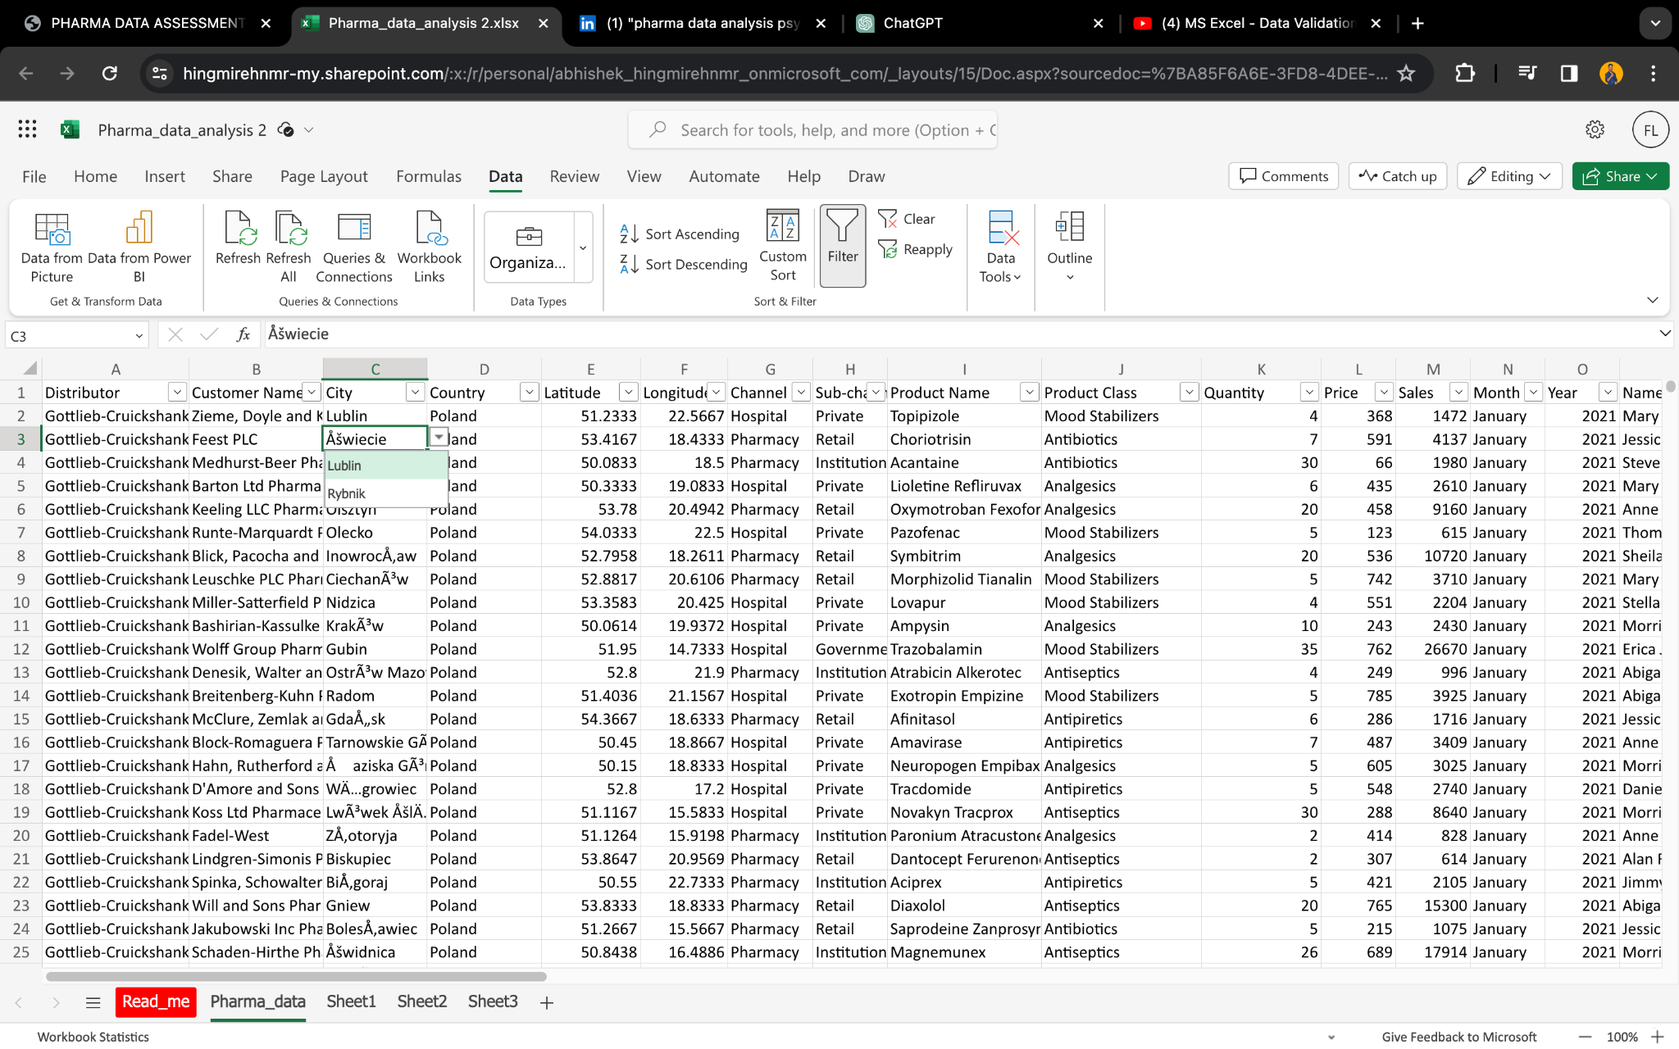
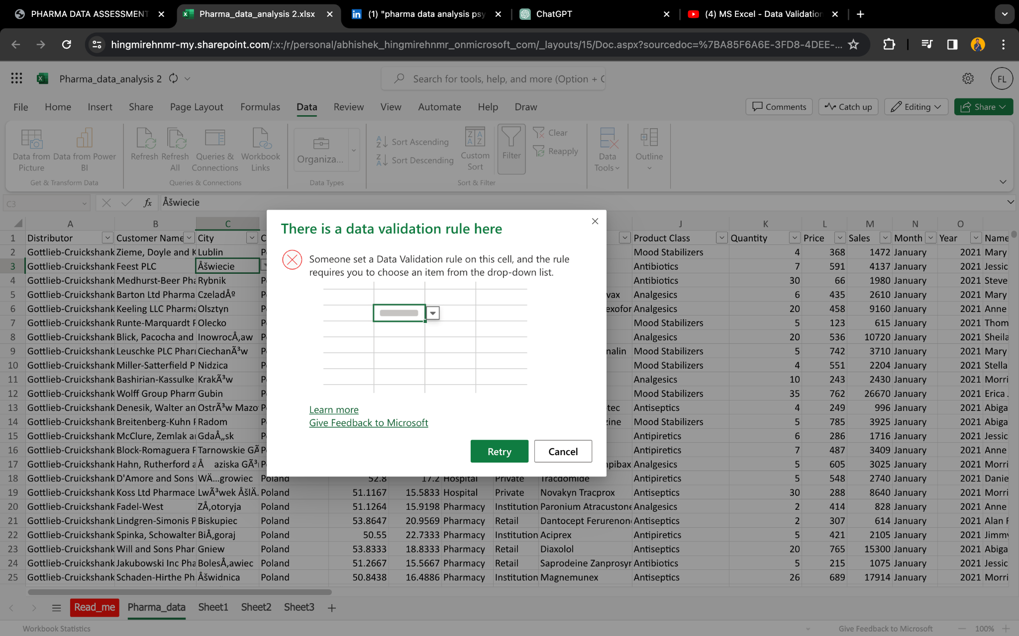
8. Data Validation: Set up data validation to allow only specific cities from a predefined list in the "City" column.

Slide 10
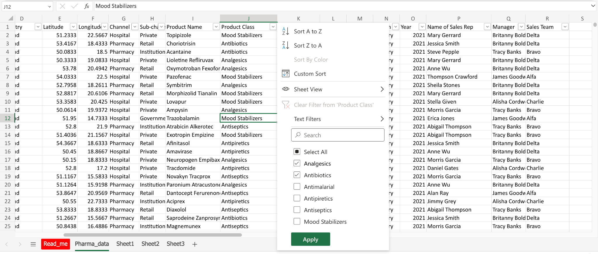
9. Advanced Filtering: Apply a filter to show records where "Product Class" is either "Electronics" or "Clothing."
There’s no “Product Class” as “Electronics” or “Clothing”. That’s why I have Filtered the data by showing the records where the “Product Class” is “Analgesics” and “Antibiotics”.

Slide 11
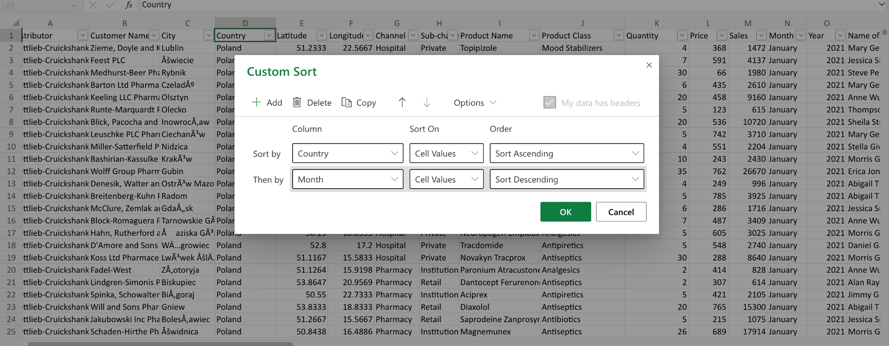
10. Sorting with Multiple Criteria: How would you sort the data first by "Country" in ascending order, and then by "Month" in descending order?

Slide 12
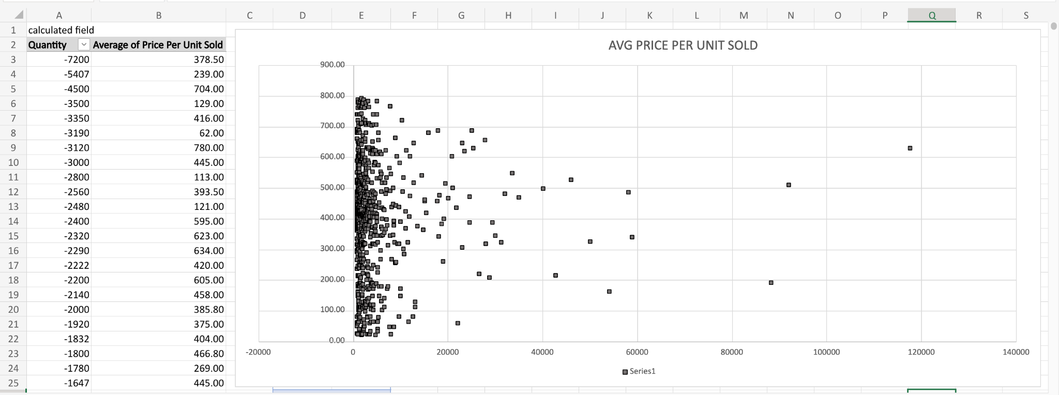
11. Calculated Fields in Pivot Table: Add a calculated field in the pivot table to calculate the average price per unit sold.

Slide 13
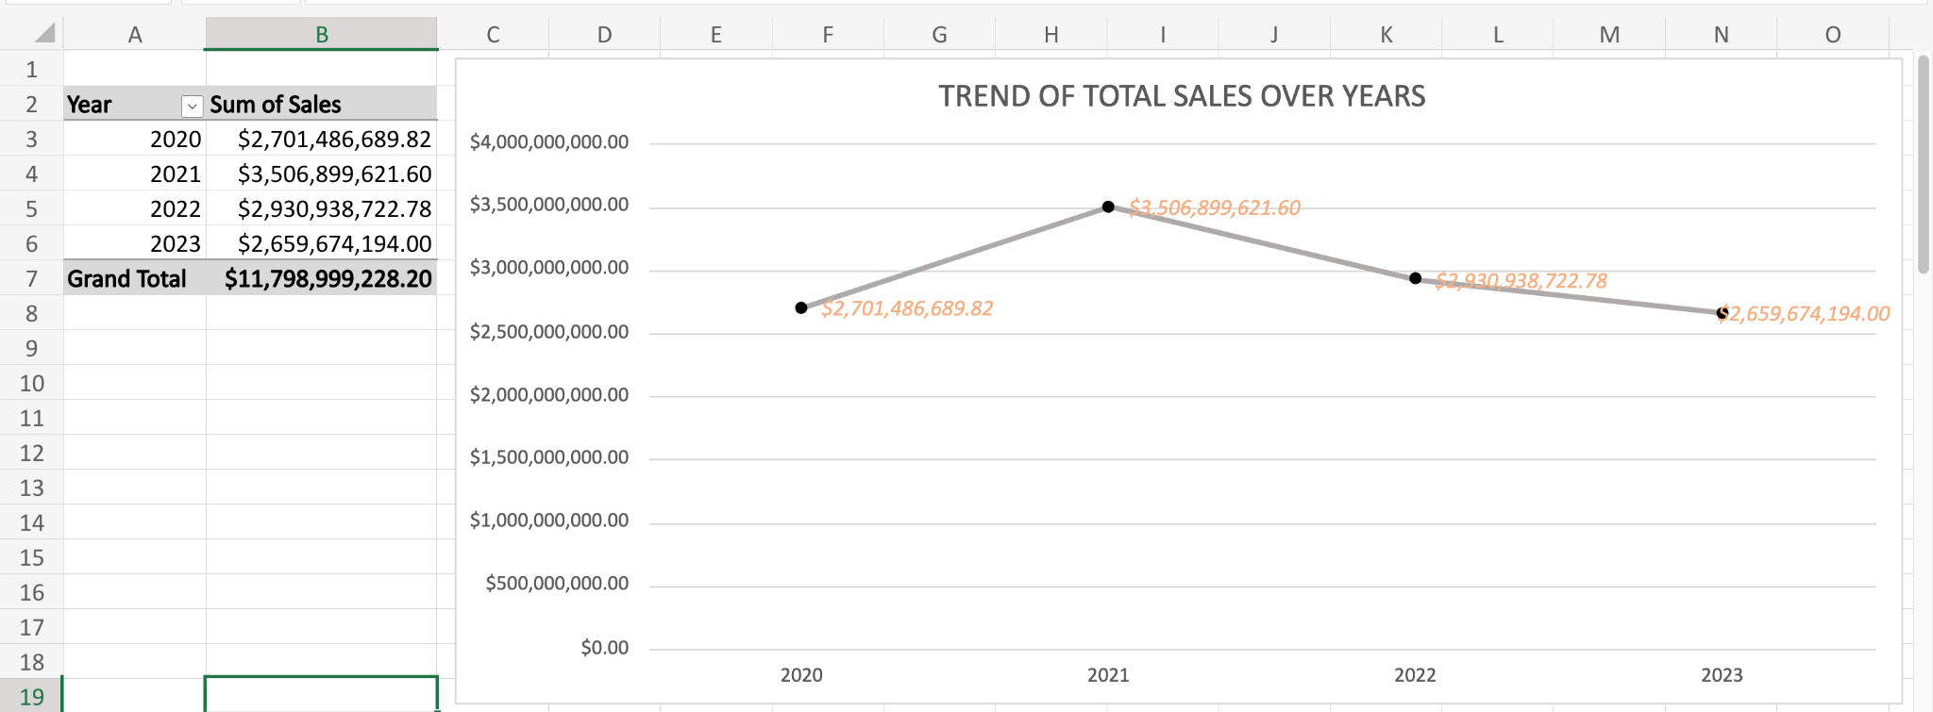
12. Advanced Charting: Create a line chart to show the trend of total sales over the years.

Slide 14
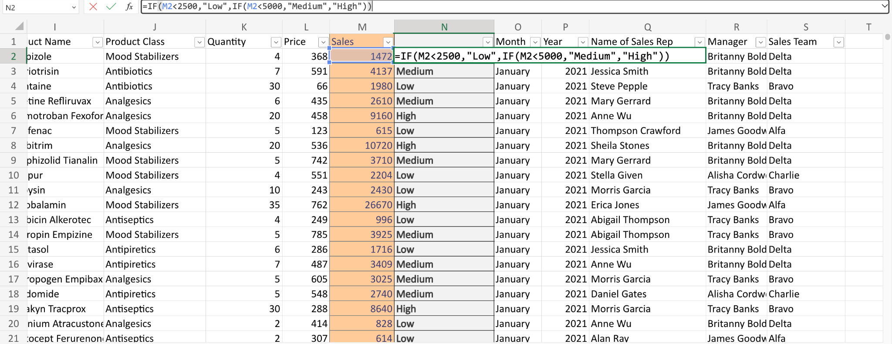
13. Nested IF Function: Use a nested IF function to categorize "Sales" into three categories: Low, Medium, and High.

Slide 15
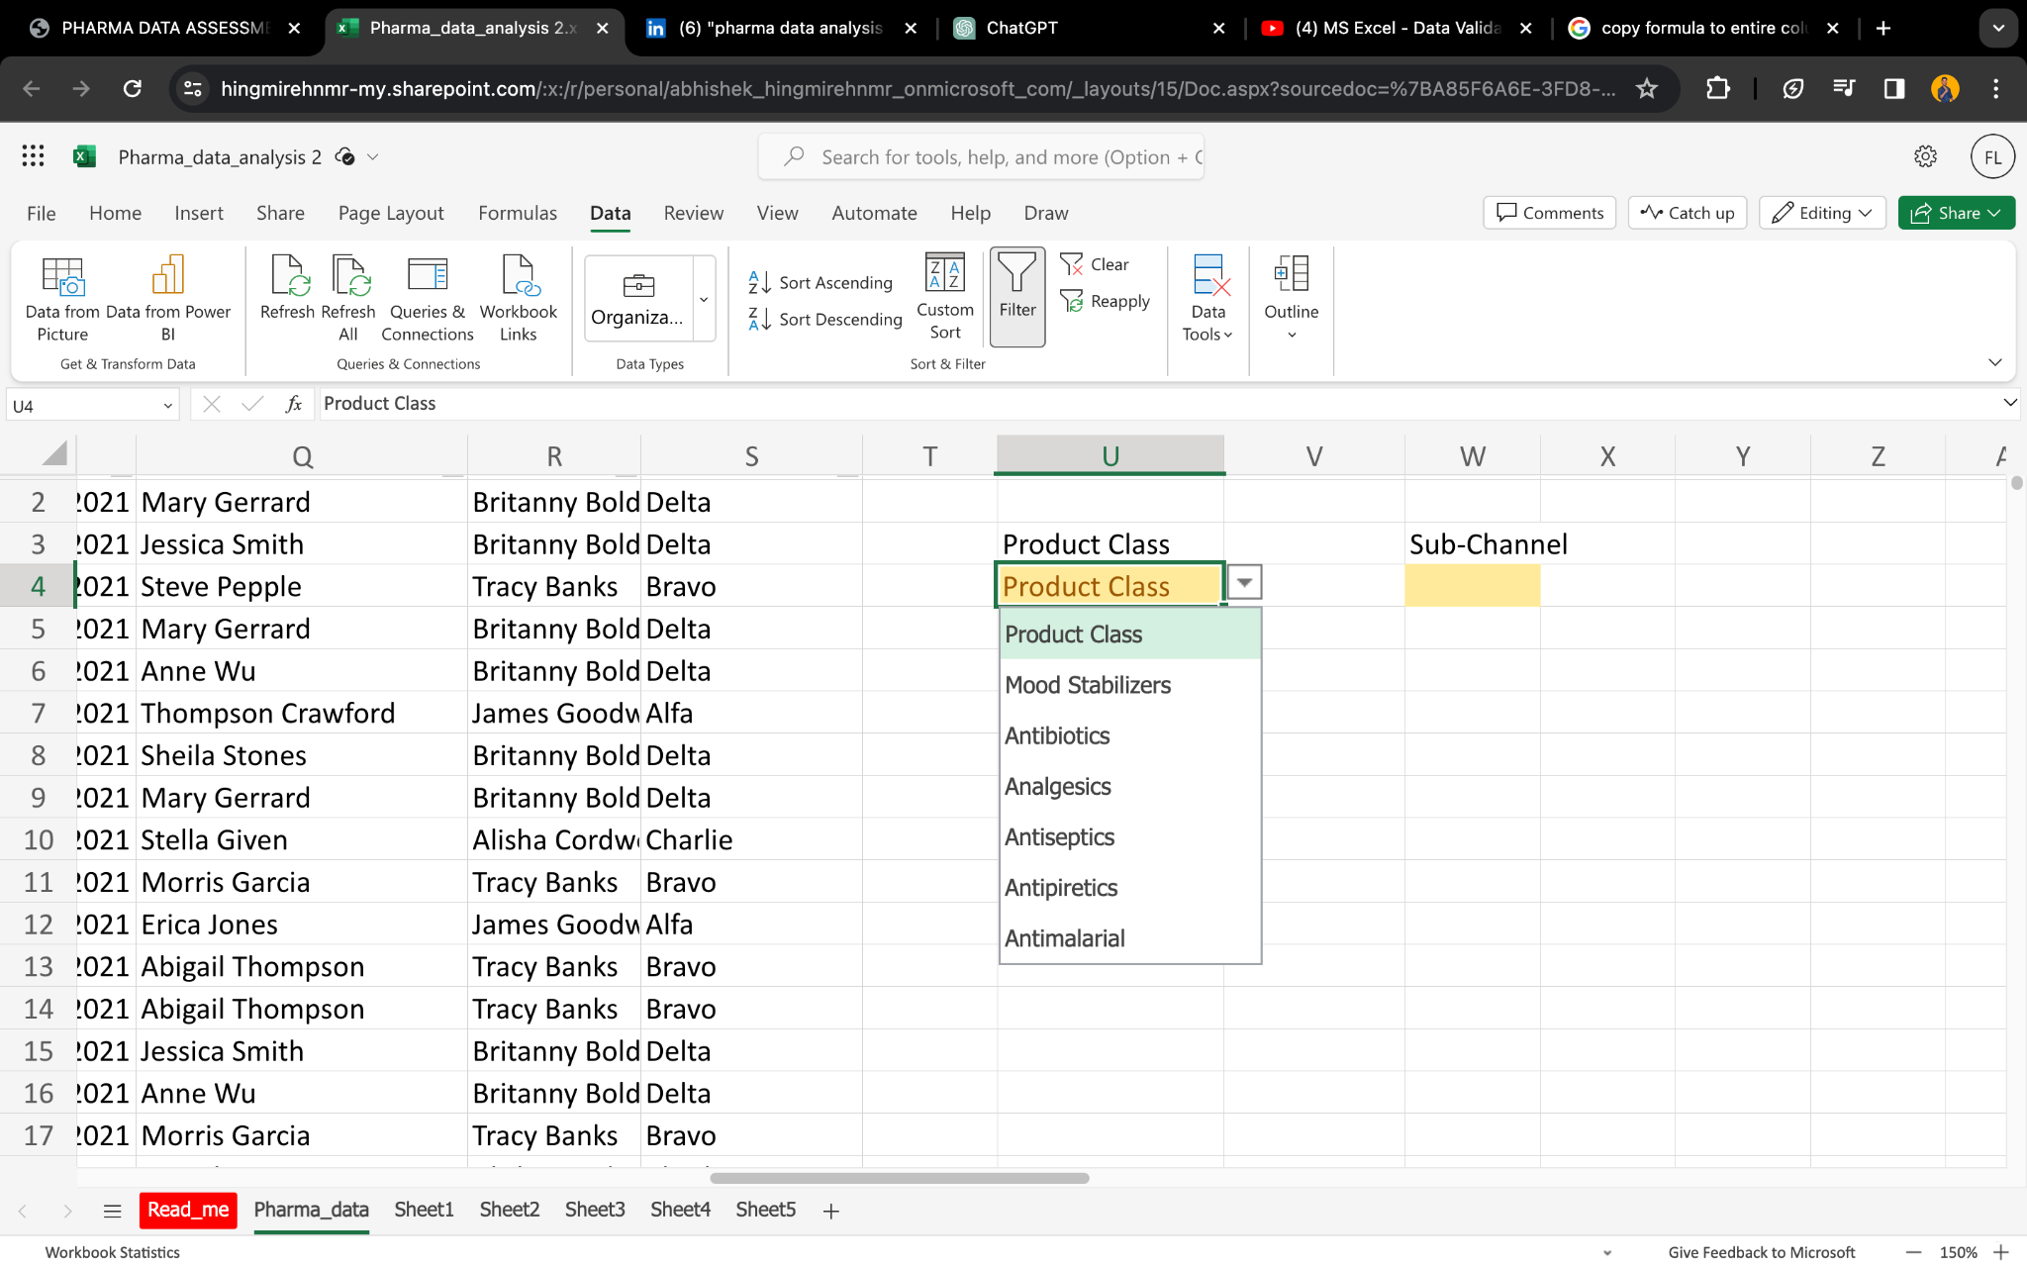
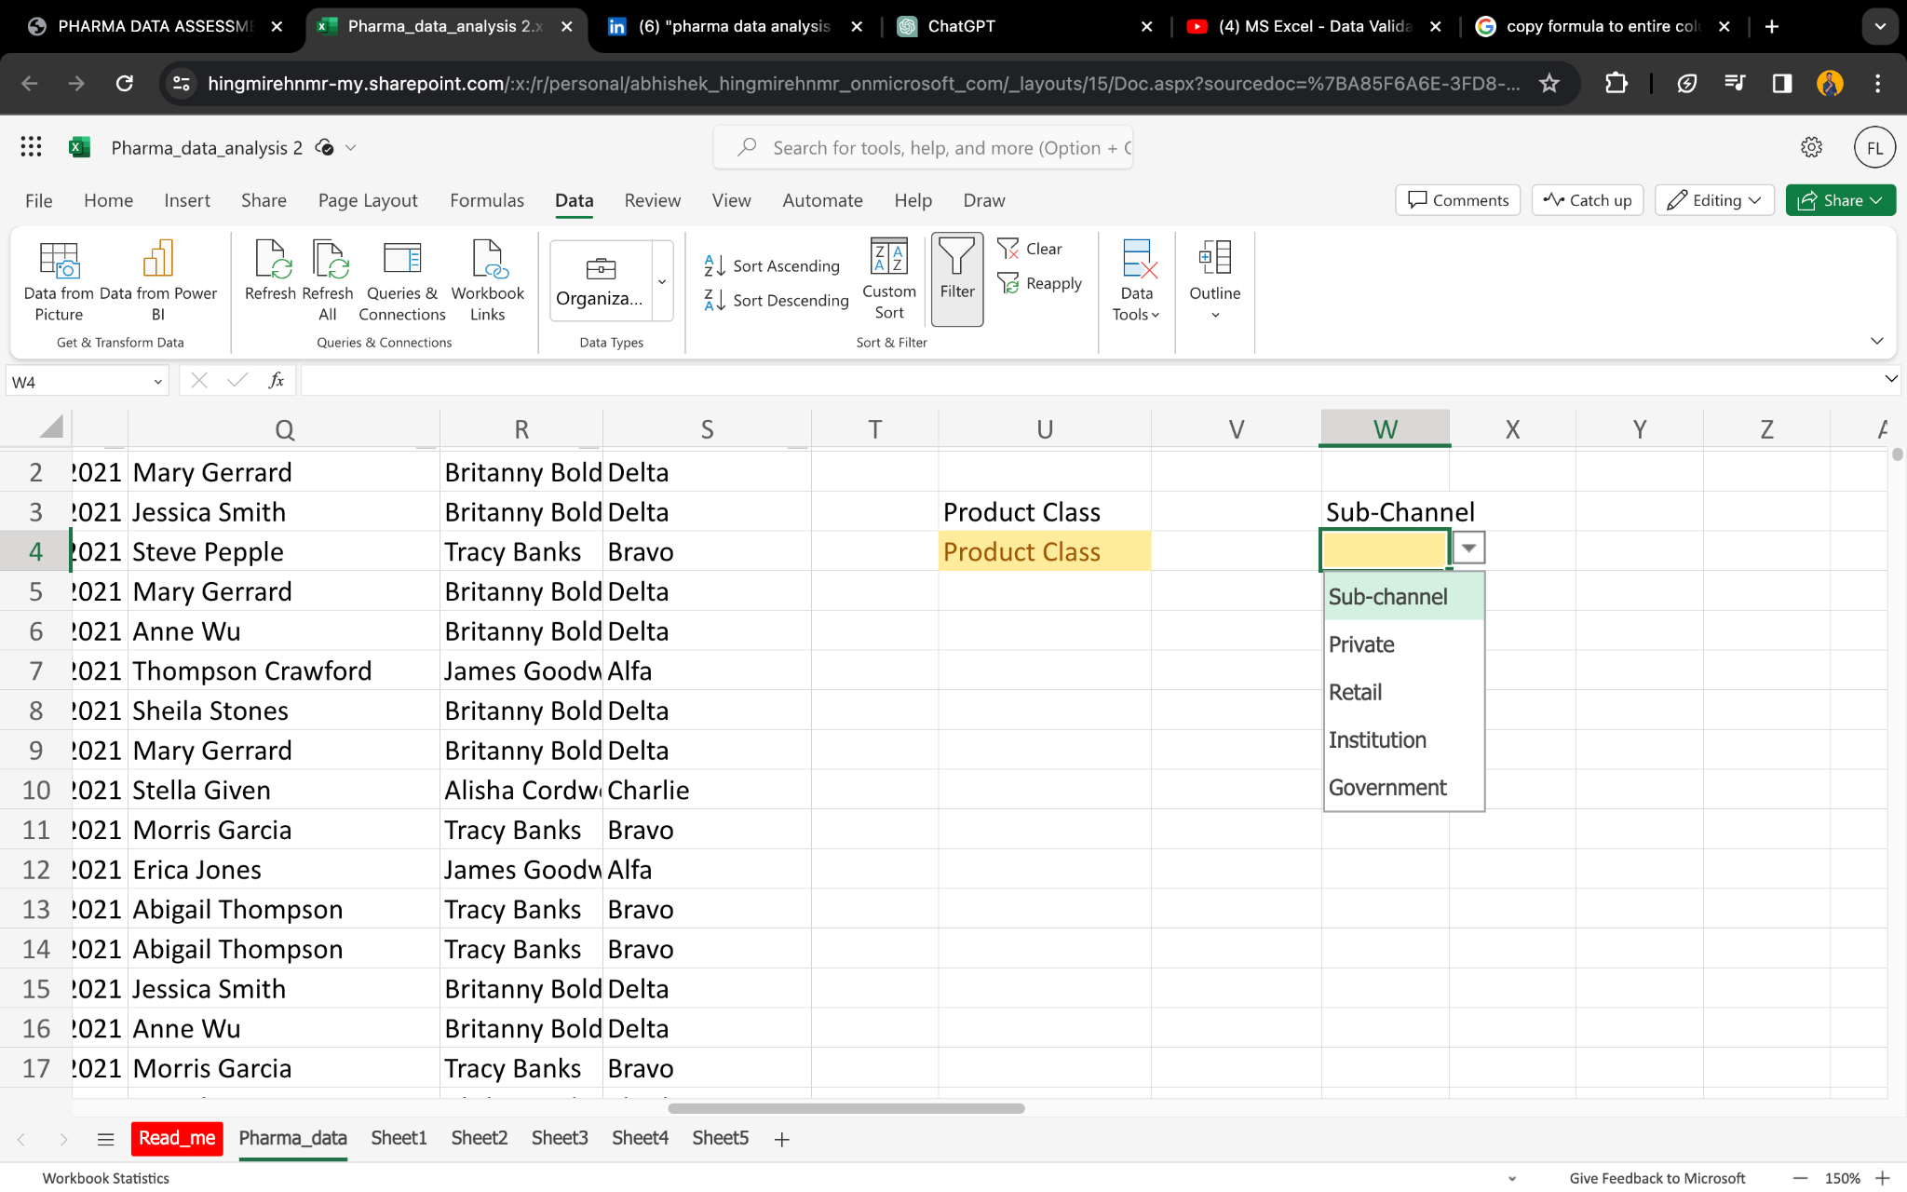
14. Data Validation with Dropdown Lists: Create dropdown lists for "Product Class" and "Sub-channel" in the data entry cells.

Slide 16
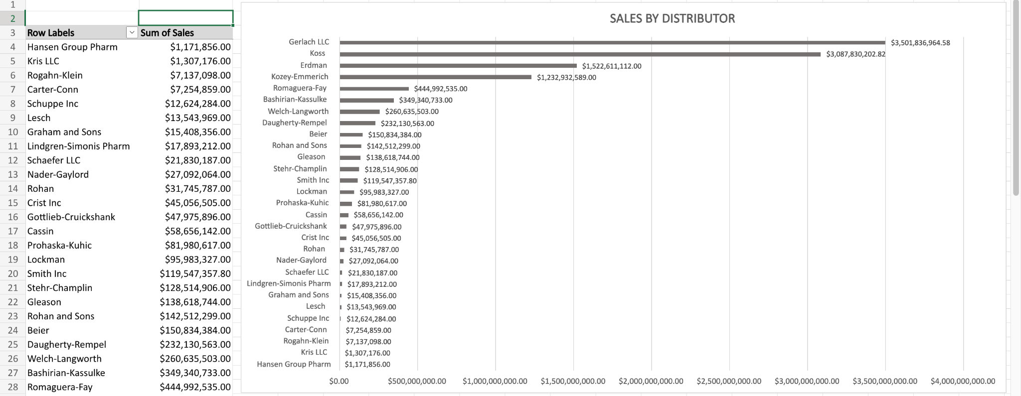
15. Pivot Chart: Turn the pivot table created earlier into a pivot chart to visualize sales by "Distributor."
1

Slide 17
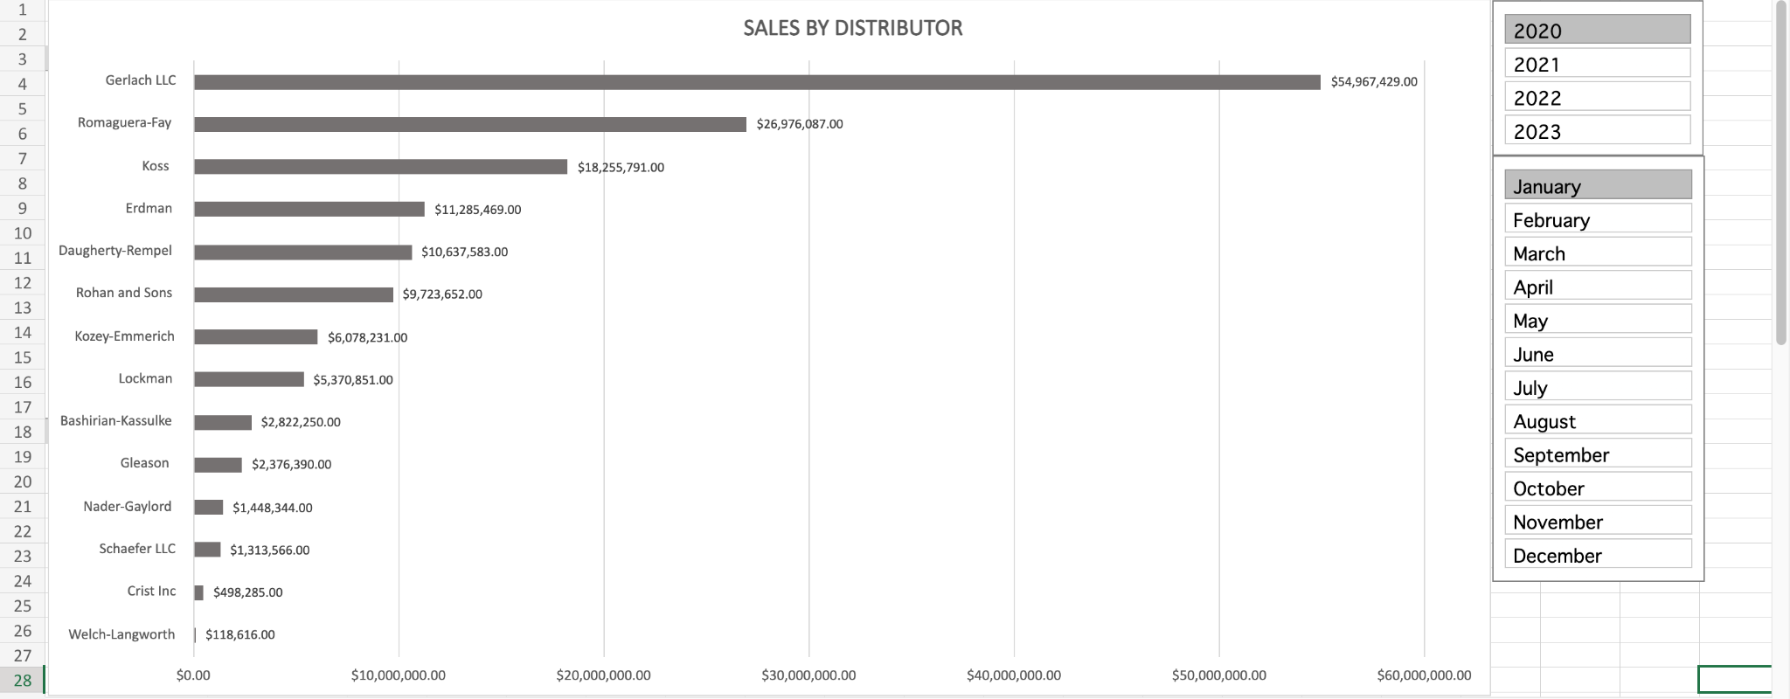
16. Pivot Table Slicers: Add slicers to the pivot table to allow easy filtering by "Month" and "Year."

Slide 18
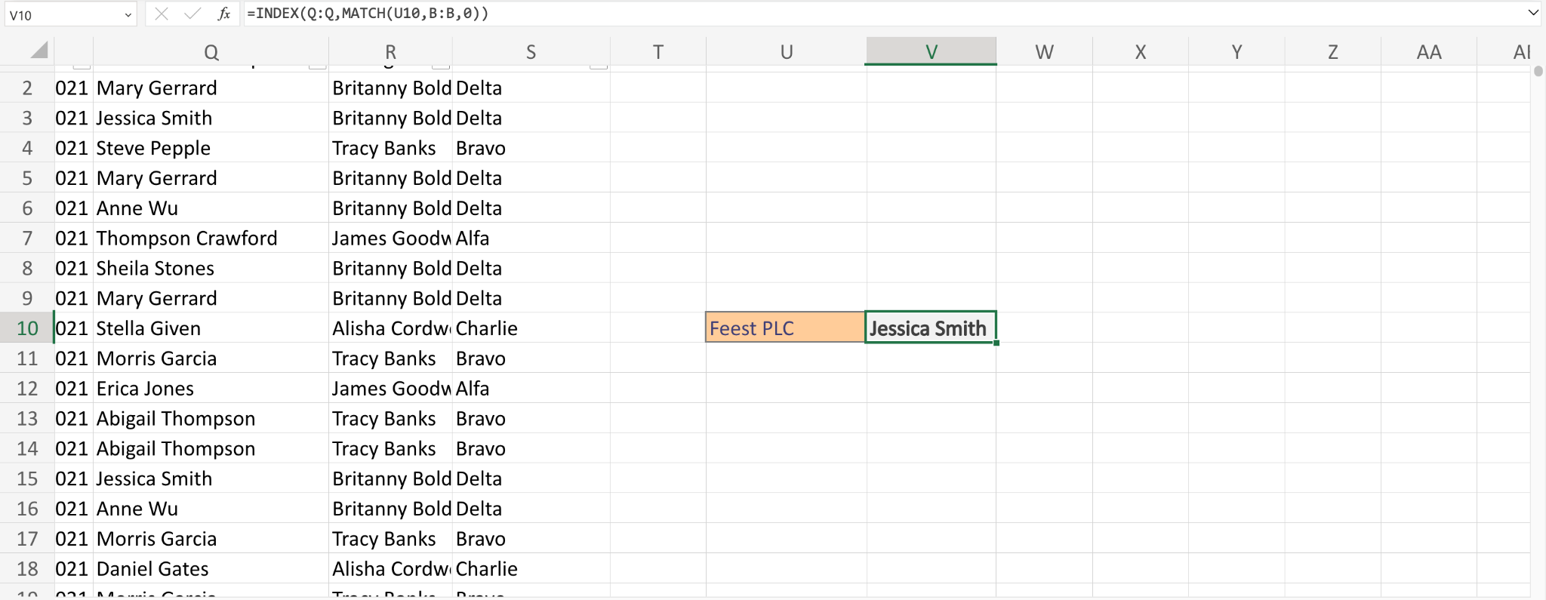
17. Lookup Functions: Use INDEX and MATCH functions to find the "Sales Rep" for a specific "Customer Name."

Slide 19
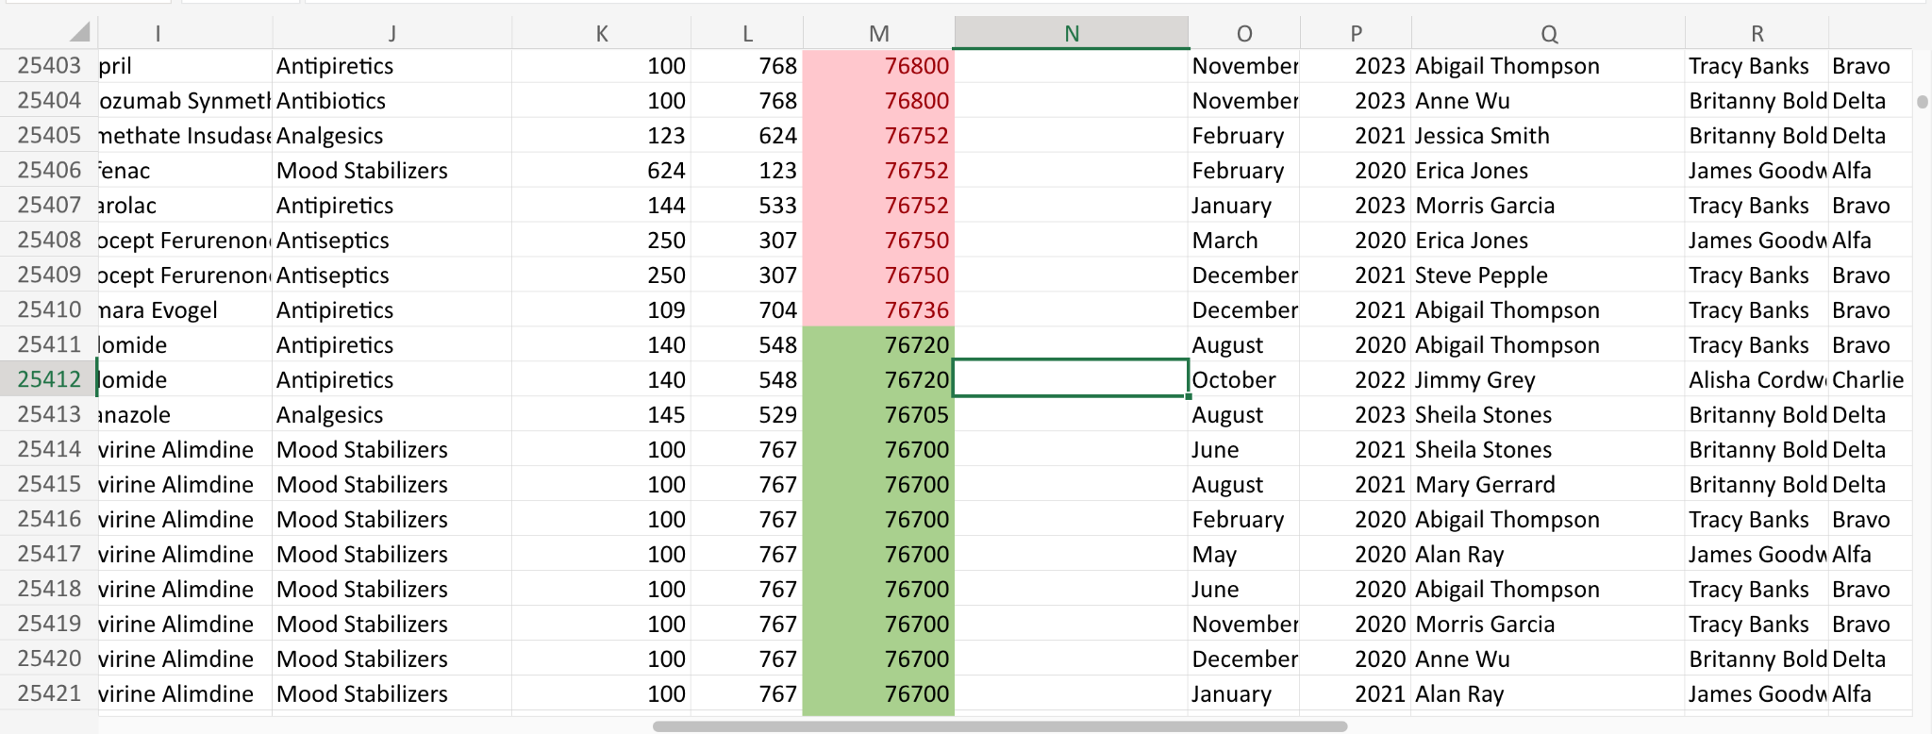
18. Advanced Conditional Formatting: Apply a custom conditional format to highlight the top 10% of sales values with a distinct color.

Slide 20
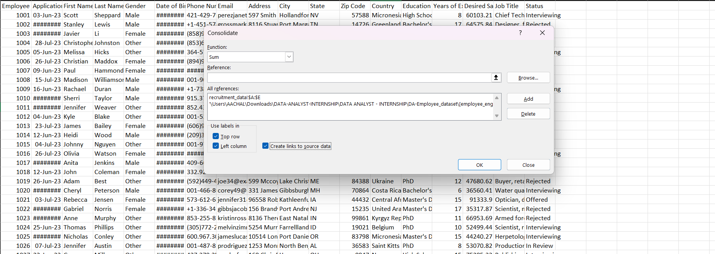
19. Data Consolidation: Consolidate data from multiple files into a single master file and create a pivot table to summarize the combined data.

Slide 21
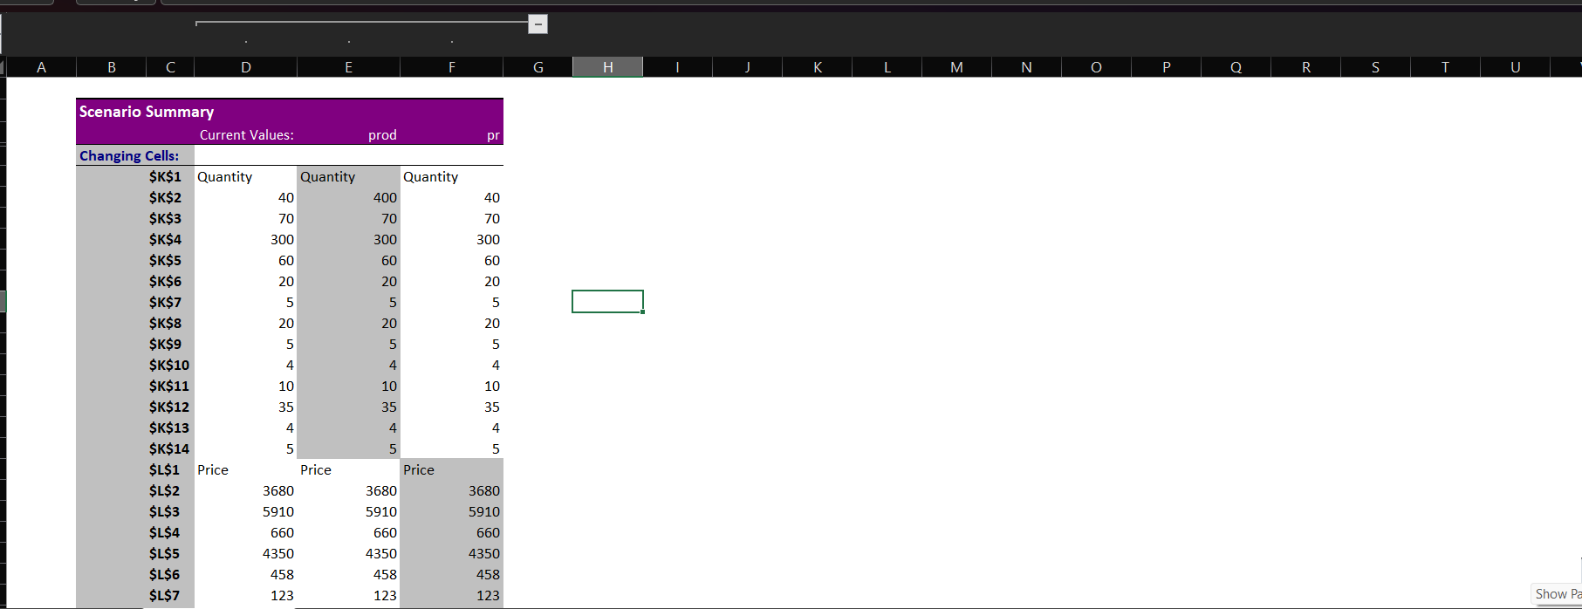
20. Scenario Manager: Use the Scenario Manager to compare different scenarios for future sales by changing variables like "Price" and "Quantity."

Slide 22
THANK YOU

